Slide 1
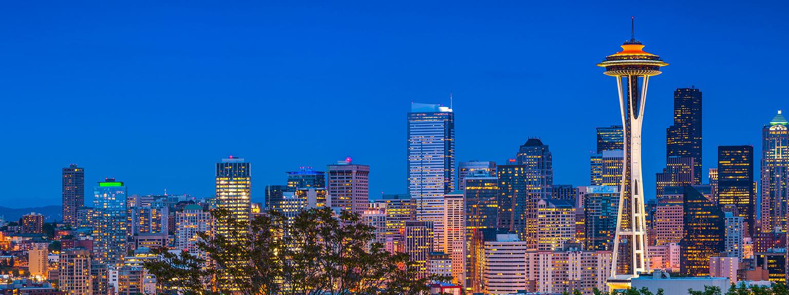
WEST COAST TECH TREK 2018

Slide 2
Key Dates and Tentative Trek Agenda
Thursday, December 7th: Registration Opens
Saturday, December 23rd: Registration Ends
Monday, January 22nd: Resume books sent to companies
Thursday, January 25th: Depart for West Coast Tech Trek!
Date | City
Thursday, 1/25 | Depart BOS to SEA
Friday (Day), 1/26 | All day company visits in Seattle
Friday (Evening), 1/26 | Dinner/Alumni Happy Hour
Friday - Saturday, 1/26-27 | Hang out in Seattle or Fly to SF!
Sunday (Evening), 1/28 | Arrive in SF
Monday (Day), 1/29 | All day company visits in SF
Monday (Evening), 1/29 | Dinner/Alumni Happy Hour
Tuesday (Day), 1/30 | All day company visits in SF
Tuesday (Evening), 1/30 | Fly out to LA/Arrive in LA
Wednesday (Day), 1/31 | All day company visits in LA
Wednesday (Afternoon/Evening) | Fly back to BOS or PARK CITY, UTAH for SLOANDANCE 2018!!!
Company Interviews to be mindful of
Jan 22-23 - Amazon PM/PMT/RLD
Jan 24-25 - Amazon OPs/PGM
Jan 25 - Cisco
*We are in the process of finalizing the rest of the companies for the visit

Slide 3
Costs & Expectations
Costs
Expectations
Trek Fee: $100 through Sloan Groups (company thank you gifts, commute between companies in each respective city (uber/lyft),
Deposit: $100 through Sloan Groups (refundable on completion of attendance):
Transportation from Airport to Hotel/Lodging is NOT included
Accommodations: NOT INCLUDED
Seattle: ~$50/night for Triple Occupancy
San Francisco: ~$75/night for Triple Occupancy
Los Angeles: ~50/night for Triple Occupancy
Airbnb may be organized after final list of attendees is determined
Follow Sloan Values through the entirety of the trek
Dress code: Business casuals
Since we are visiting tech companies, it’s not necessary to dress up in formals
We recommend getting to Seattle the night before (Jan. 25th) so there is no delay in starting the trek.

Slide 4
Potential Company Visits - Seattle

Slide 5
Potential Company Visits - San Francisco
San Francisco
Palo Alto/San Jose

Slide 6
Potential Company Visits - Los Angeles
Honey

Slide 7
THANK YOU!
For any other info, contact:
Adeel Mallick - amallick@mit.edu
Talha Aftab - maftab@mit.edu
Pauline Coherco - pcoherco@mit.edu
Pete Horgan - peterh@mit.edu
Bahar Alipour - alipour@mit.edu
Chandrika Maheshwari - chandrika@sloan.mit.edu

